Slide 1
Computer Networks

Slide 2
#whoami
Vipin George
Cyber Forensic consultant at KEPA
M.Tech in Cyber Forensics and InfoSec
Worked as a Network Engineer for a Tier- 1 ISP
Mozillian
Wikipedian

Slide 3
Computer Networks

Slide 4
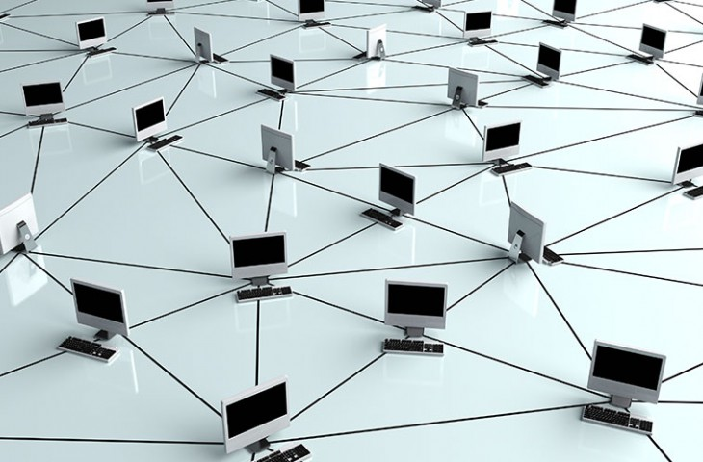
Computer Network
Computer network is a group of computers and other computing hardware devices (printers, scanners etc.) connected to each other through a communication medium.

Slide 5
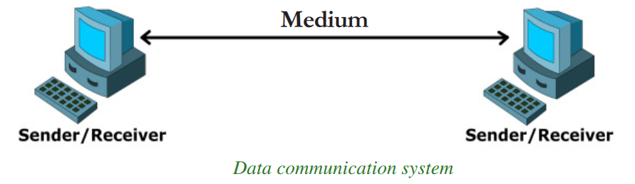
Data communication system
the exchange of digital data between any two devices through a medium of transmission

Slide 6
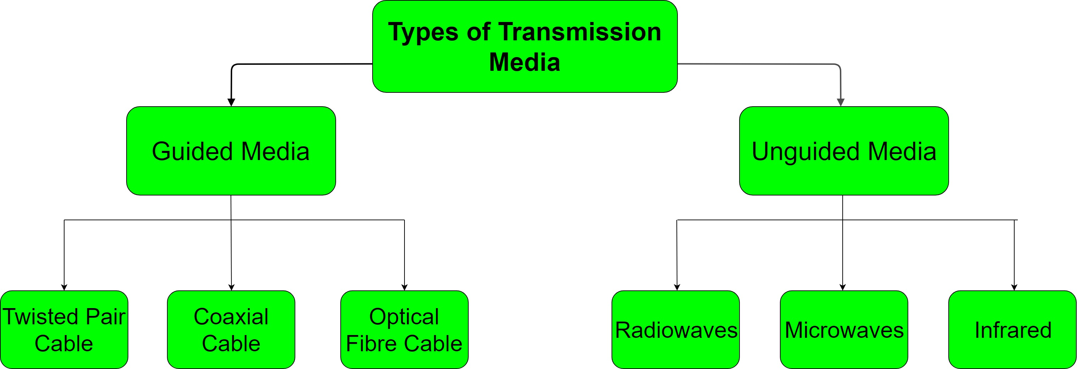
Communication media

Slide 7
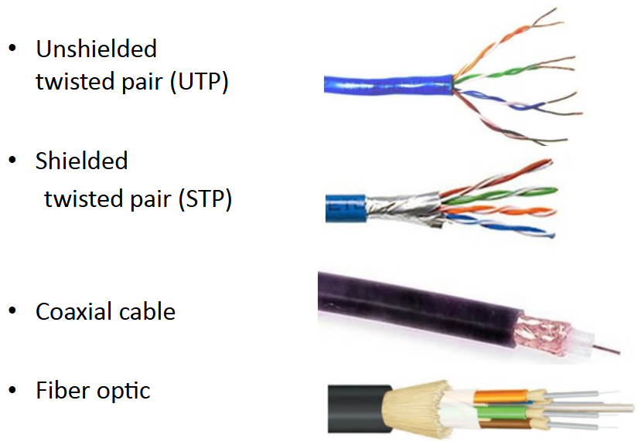
Guided Media

Slide 8
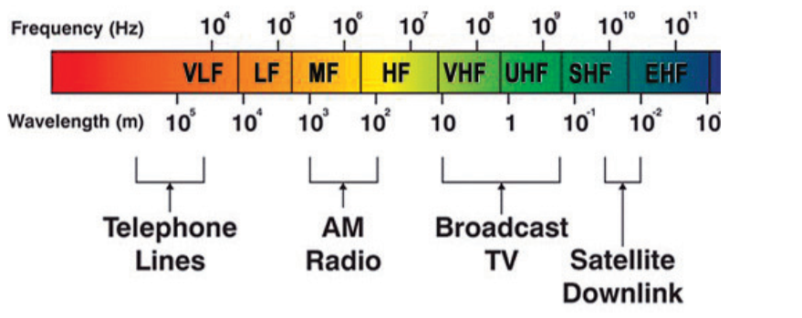
Unguided medium
1. Radio waves
Frequency range of 3 KHz to 3 GHz.

Slide 9
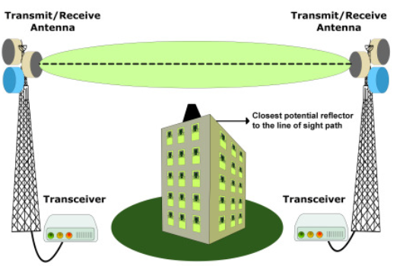
Unguided medium
2. Micro waves
Frequency range of 300 MHz (0.3 GHz) to 300 GHz

Slide 10
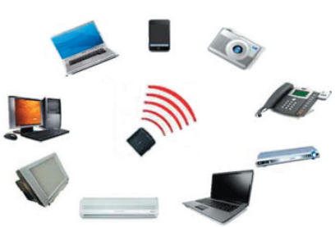
Unguided medium
3. Infrared waves
Infrared waves have a frequency range of 300 GHz to 400 THz

Slide 11
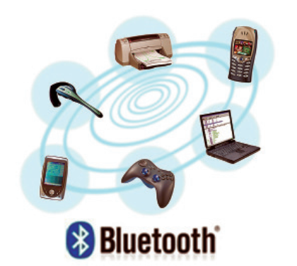
Wireless communication technologies using radio waves
1. Bluetooth
Frequency range of 2.402 GHz to 2.480 GHz.
used for short range communication
Bluetooth 5.0

Slide 12
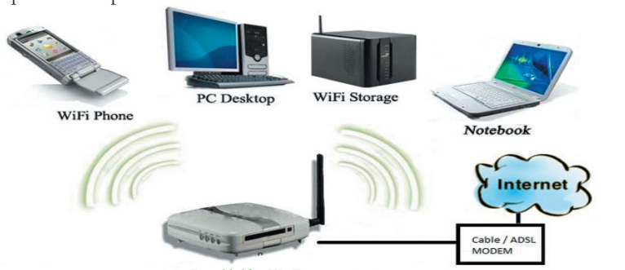
Wireless communication technologies using radio waves
2. Wi-Fi
Frequency of 2.4 GHz to 5 GHz
Line of sight between communicating devices is not required.

Slide 13
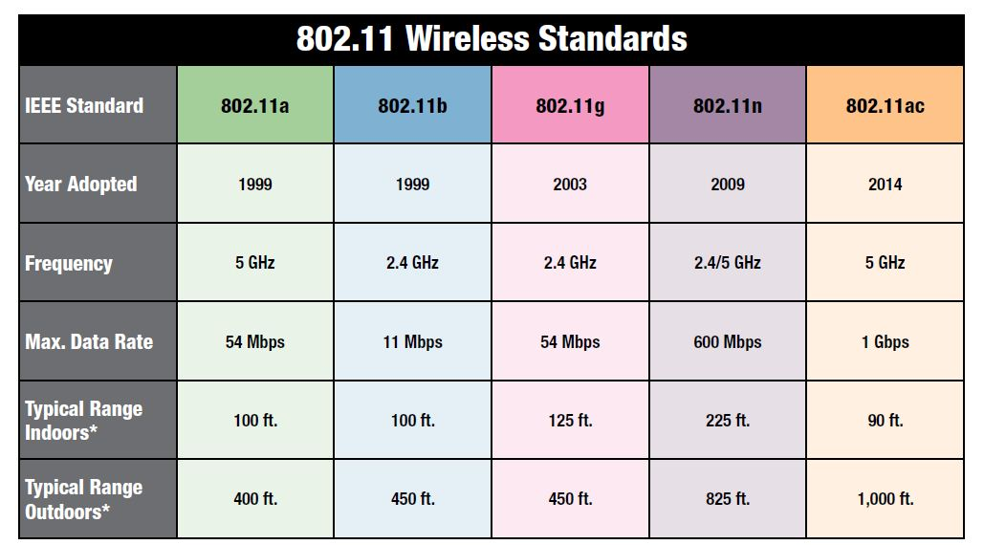
Wireless communication technologies using radio waves

Slide 14
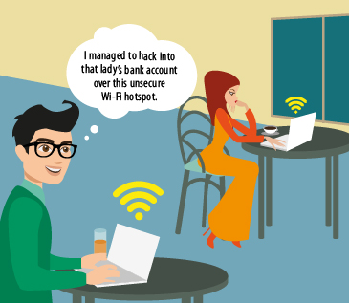
Man in the Middle Attacks
Unsecure Wi-Fi

Slide 15
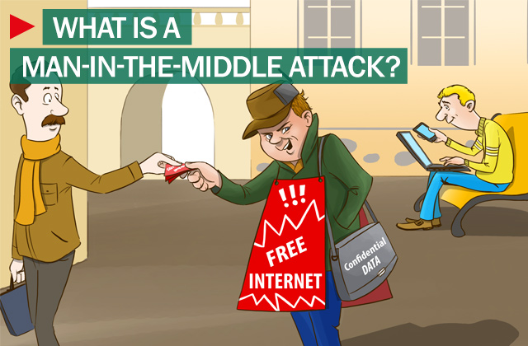
Man in the Middle Attacks

Slide 16
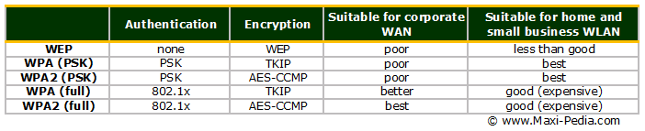
Wireless communication technologies using radio waves

Slide 17
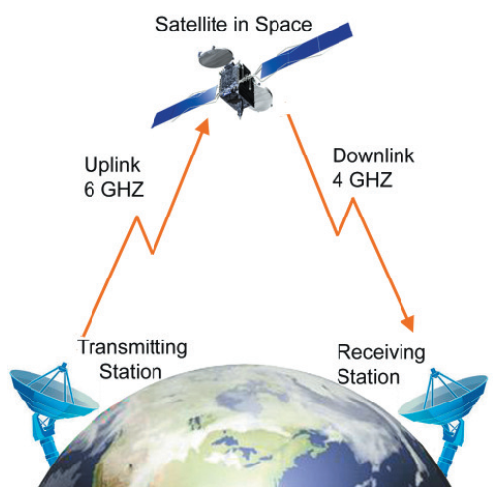
Wireless communication technologies using radio waves
3. Satellite link
Frequency used for
Uplink 1.6 GHz to 30.0 GHz
Downlink 1.5 GHz to 20.0 GHz.

Slide 18
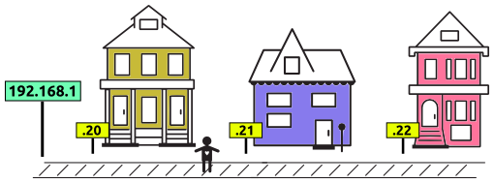
NETWORKING
IP addresses
In order to send and direct data across a network, computers need to be able to identify destinations and origins

Slide 19
NETWORKING
IP addresses
An IP address is just a set of four numbers between 1 and 254, separated by dots eg: 192.168.1.20

Slide 20
NETWORKING
IP addresses
An IP address is similar to a street address
Below we can see 192.168.1 Street. On it are three houses:

Slide 21
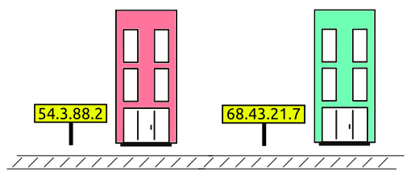
IP addresses
A network can be public or private
Public IP addresses are accessible anywhere on the Internet.
Private IP addresses are not(most are hidden behind a device with a public IP address).

Slide 22
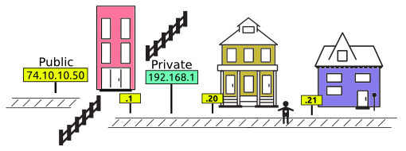
IP addresses
Look at 192.168.1 Street. We have a new building on the street. That building has a public IP address, and a private IP address. A fence that blocks the rest of the Internet

Slide 23
IP addresses
Our public IP address?
Visit http://whatismyip.host/

Slide 24
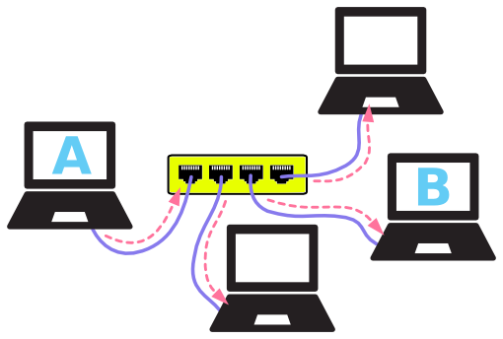
Data Communication devices
Computers are connected to each other using cables - creating a network.

Slide 25
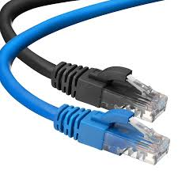
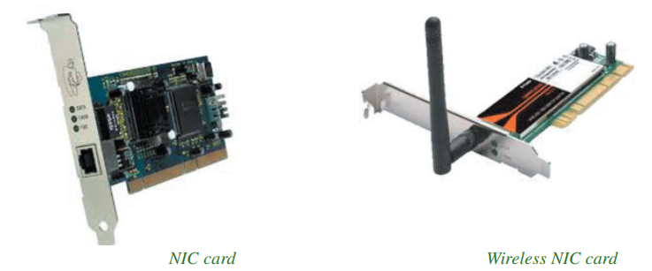
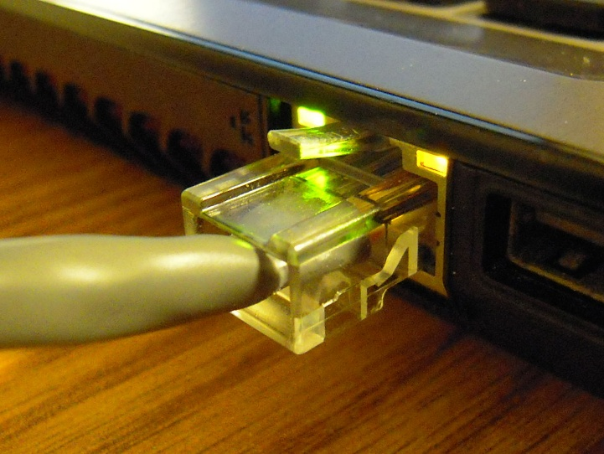
Data Communication devices
1. Network Interface Card (NIC)

Slide 26
2. Network Hubs
Computer A wants to send a message to computer B. It sends the message through the cable to the hub, then the hub repeats the message to all of the connected computers.

Slide 27
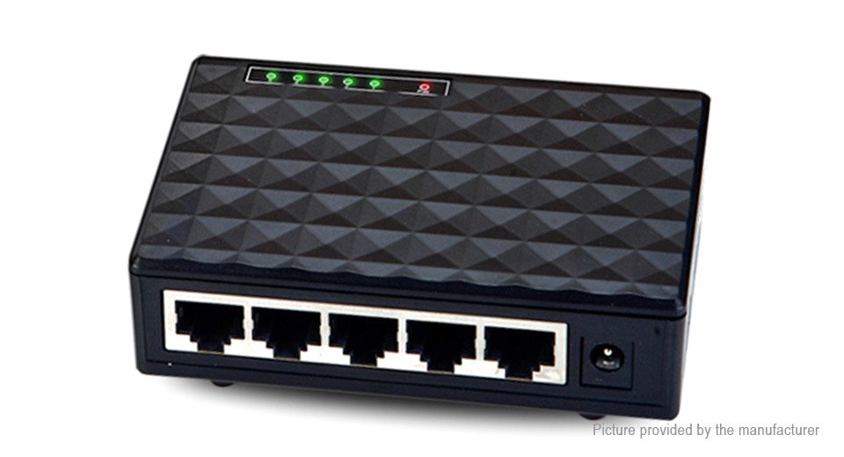
2. Network Hubs
Computer A wants to send a message to computer B. It sends the message through the cable to the hub, then the hub repeats the message to all of the connected computers.

Slide 28
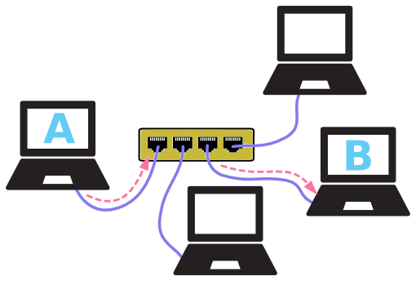
3. Switches
computer A sends a message to computer B - the other computers do not see the message.

Slide 29
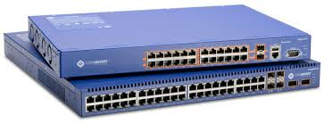
3. Switches
computer A sends a message to computer B - the other computers do not see the message.

Slide 30
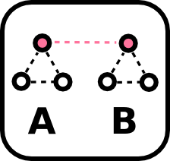
4. Routers
Routers separate networks into sections, or bridge different networks together

Slide 31
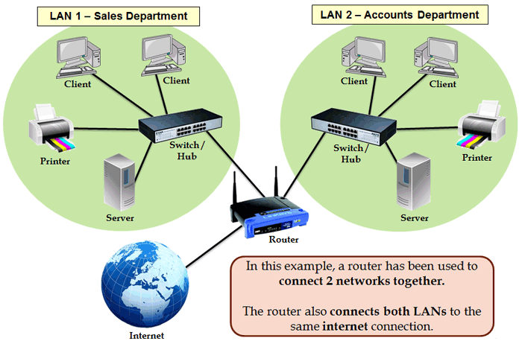
4. Routers
Routers separate networks into sections, or bridge different networks together

Slide 32
4. Routers
Assign IPs: They can assign IP addresses. In 192.168.1 Street, if a new house is built on the street, it would get whatever the next highest house number available.

Slide 33
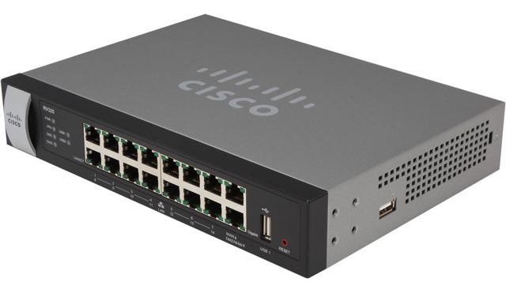
4. Routers
Assign IPs: In the case of routers, they assign IP addresses using DHCP - Dynamic Host Configuration Protocol.

Slide 34
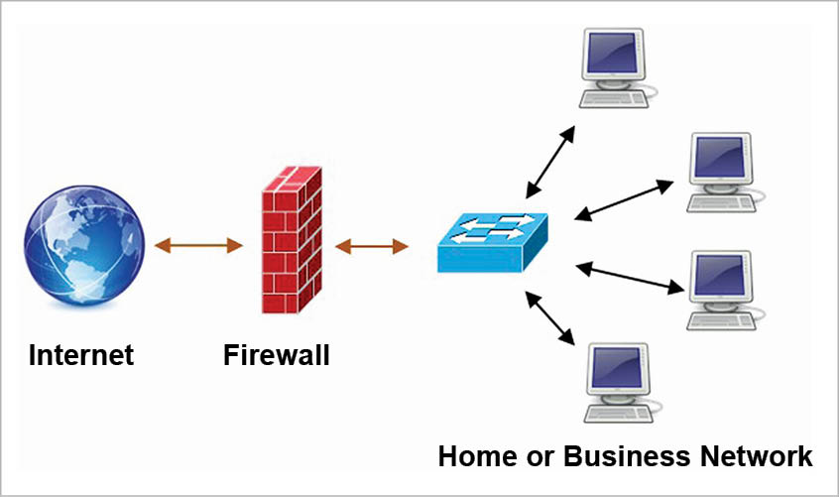
5. Firewall
to prevent unauthorized access to the network

Slide 35
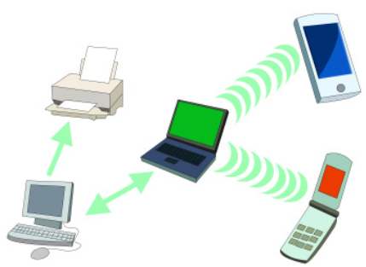
Types of networks
1. Personal Area Network (PAN)
PAN is a network of communicating devices (computer, mobile, tablet, printer, etc.) in the proximity of an individual. It can cover an area of a radius with few meters

Slide 36
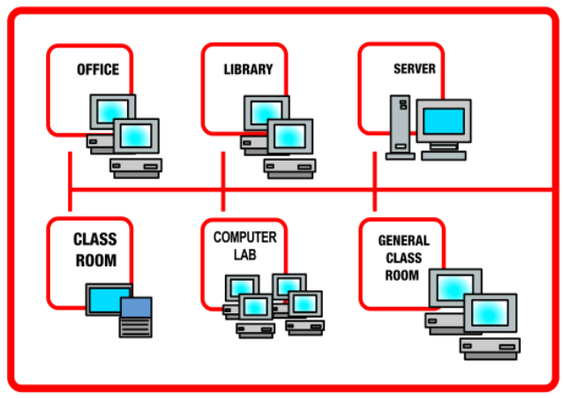
Types of networks
2. Local Area Network (LAN)
Network of Computing and Communicating devices in a room, building, or campus.

Slide 37
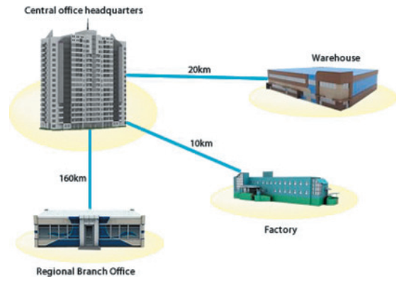
Types of networks
3. Metropolitan Area Network (MAN)
Communicating devices within a city, few Kilometres to a few hundred Kilometres radius

Slide 38
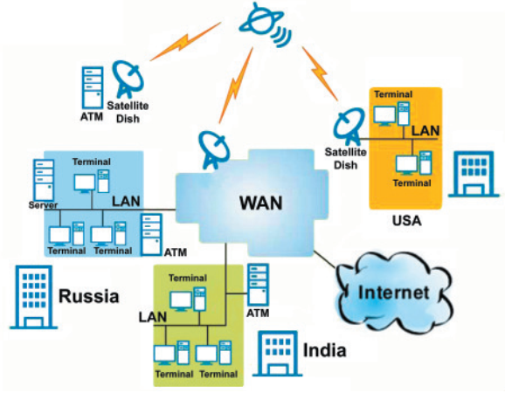
Types of networks
4. Wide Area Network (WAN) Computing and Communicating devices crossing the limits of a city, country or continent.

Slide 39
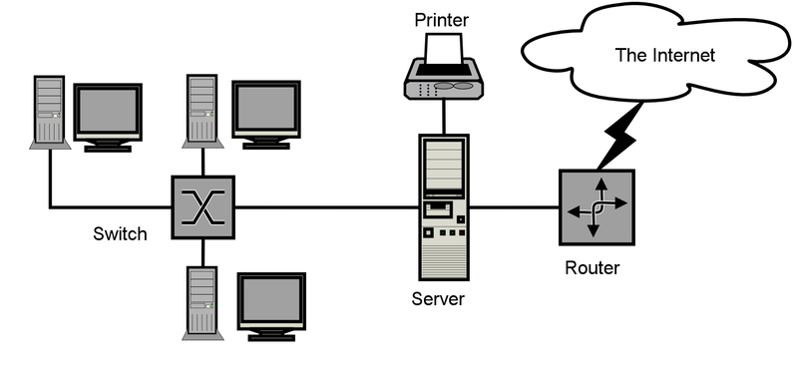
Basic Network Diagram

Slide 40
Identification of computers over a network
Once a network has been set up, the nodes can communicate among themselves.
But for proper communication, the nodes should be uniquely identifiable.

Slide 41
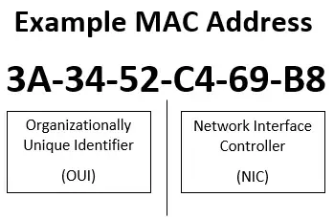
Identification of computers over a network
1. Media Access Control (MAC) address
It is a universally unique address assigned to each NIC (Network Interface Card) by its manufacturer.
It is permanent and never changes.
MAC addresses are 12-digit hexadecimal (or 48 bit binary) numbers.

Slide 42
Identification of computers over a network
1. Media Access Control (MAC) address
MAC address lookup https://aruljohn.com/mac.pl
https://aruljohn.com/mac/0CCB85

Slide 43
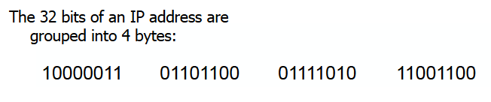
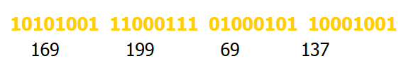
Identification of computers over a network
2. Internet Protocol (IP) address
IP address is assigned to each machine by the network administrator or the Internet Service Provider.

Slide 44
Identification of computers over a network
2. Internet Protocol (IP) address
There are two versions of IP addresses:
version 4 (IPv4) and
version 6 (IPv6)
IPv4 uses 32 bits and IPv6 uses 128 bits for an IP address.

Slide 45
Identification of computers over a network
IPv6 address eg: 2001:0db8:85a3:0000:0000:8a2e:0370:7334
2. Internet Protocol (IP) address
IP address lookup http://whatismyip.host

Slide 46

Questions

Slide 47




Reach me
@vipinonline
linkedin.com/in/vipingeo
t.me/vipinonline
www.vipinonline.com
E-mail: cek.vipin@gmail.com

Slide 48
Thank You!

Slide 49
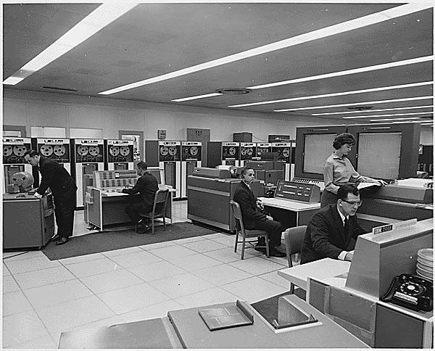
A Brief History - ARPANET
In the mid-1960s, mainframe computers in research organizations were stand-alone devices

Slide 50
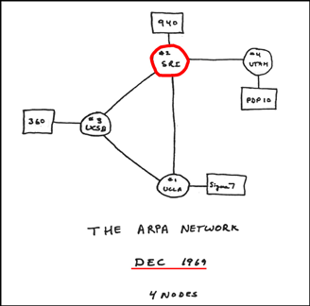
A Brief History - ARPANET
In 1967, at an Association for Computing Machinery (ACM) meeting, ARPA presented its ideas for ARPANET, a small network of connected computers

Slide 51
A Brief History - ARPANET
By 1969, ARPANET was a reality with Four nodes
The University of California at Los Angeles (UCLA)
The University of California at Santa Barbara (UCSB),
Stanford Research Institute (SRI) and
The University of Utah
were connected to form a network.

Slide 52
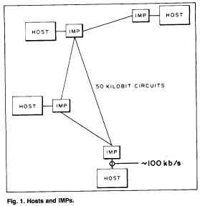
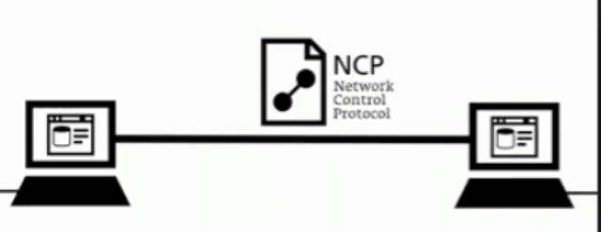
A Brief History - ARPANET
Software called the Network Control Protocol (NCP) provided communication between the hosts.

Slide 53
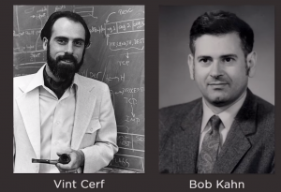
Birth of the Internet
In 1972, Vint Cerf and Bob Kahn, both of whom were part of the core ARPANET, collaborated on what they called the Internetting Project
They wanted to link different networks together so that a host on one network could communicate with a host on a second, different network.

Slide 54
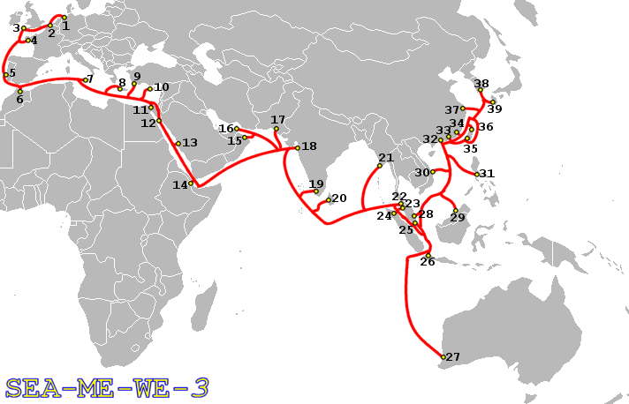
Connectivity
How are we connected to Internet?

Slide 55
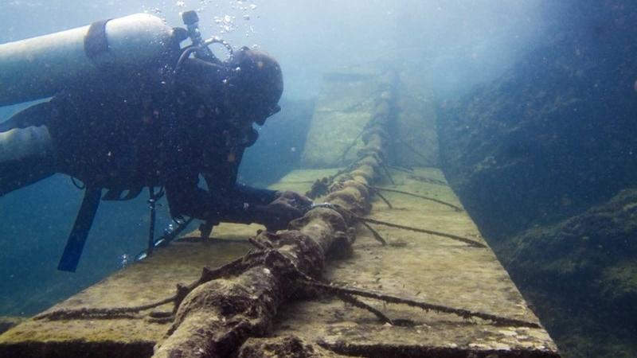
Connectivity
How are we connected to Internet?
https://www.submarinecablemap.com/

Slide 56
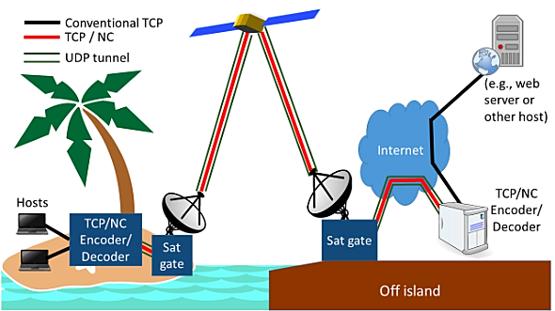
Connectivity - Satellite link

Slide 57
Internet today
Internet today is made up of many wide and local area networks joined by connecting devices and switching stations
Internet connection use the services of Internet service providers (ISPs)
There are international service providers, national service providers, regional service providers, and local service providers.

Slide 58
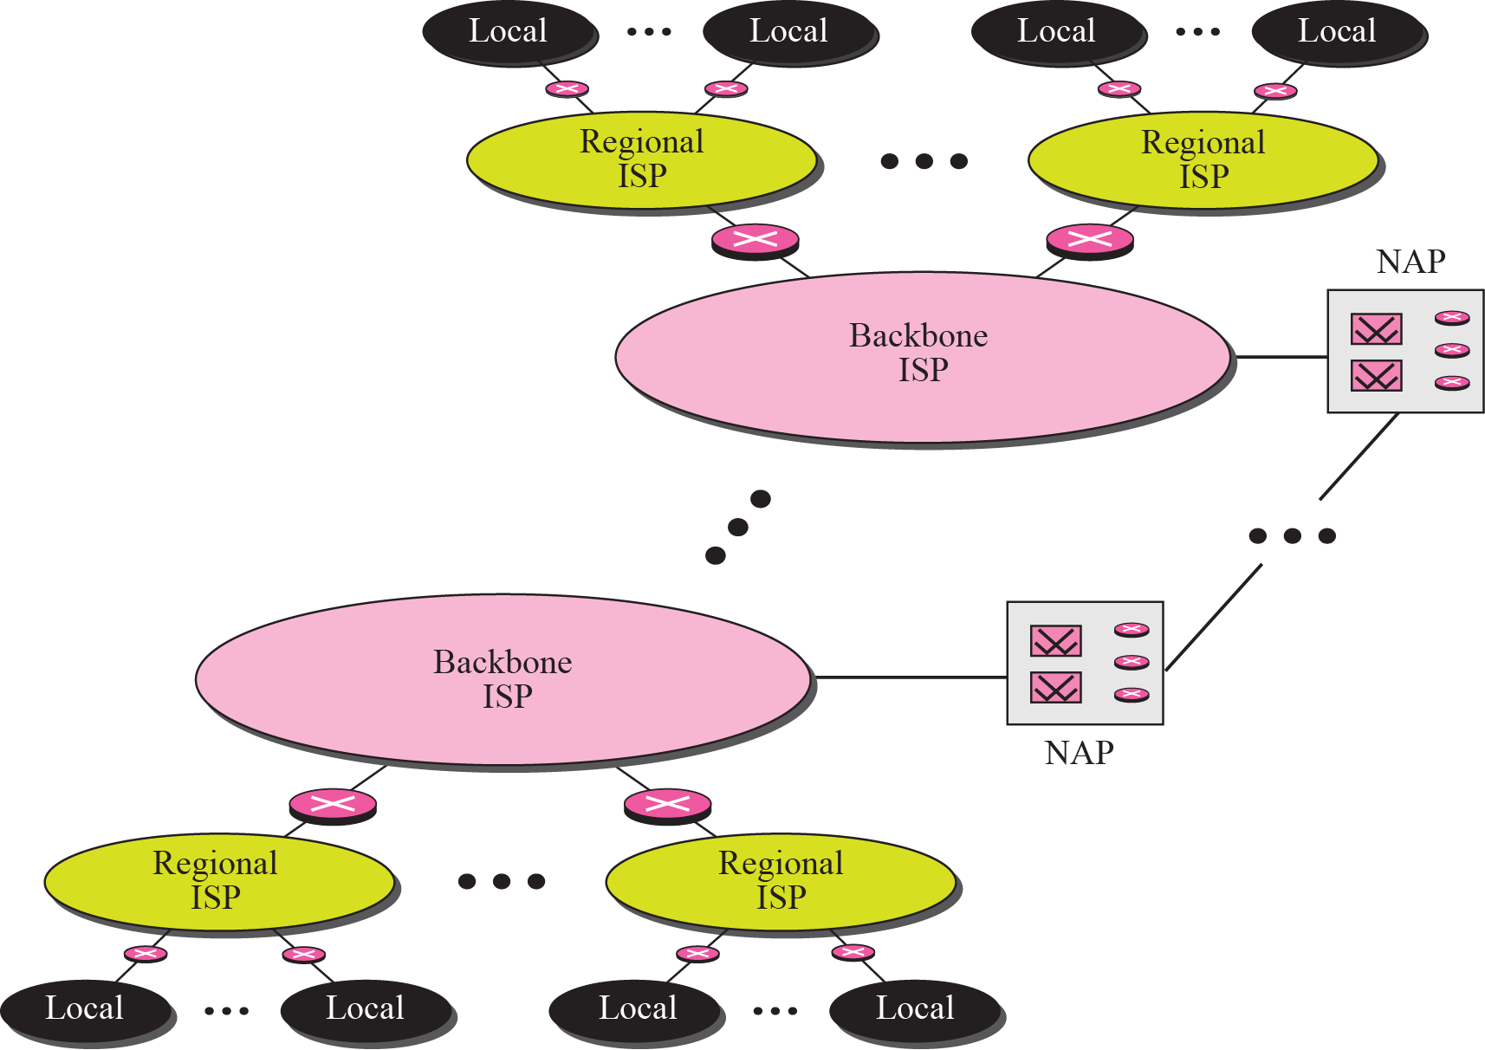
Internet today

Slide 59
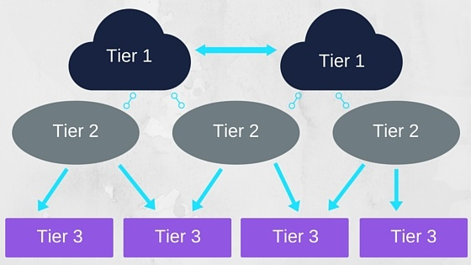
Internet today
Backbone ISPs
Backbone ISPs are created and maintained by specialized companies
Backbone ISPs normally operate at a high data rate (10 Gbps)
Eg: BSNL (NIB-II)

Slide 60
Internet today
Regional ISPs
Regional ISPs are small ISPs that are connected to one or more backbone ISPs
They are at the second level of hierarchy with a lesser data rate.

Slide 61
Internet today
Local ISPs
Local ISPs provide direct service to the end users
Most end users are connected to the local ISPs

Slide 62
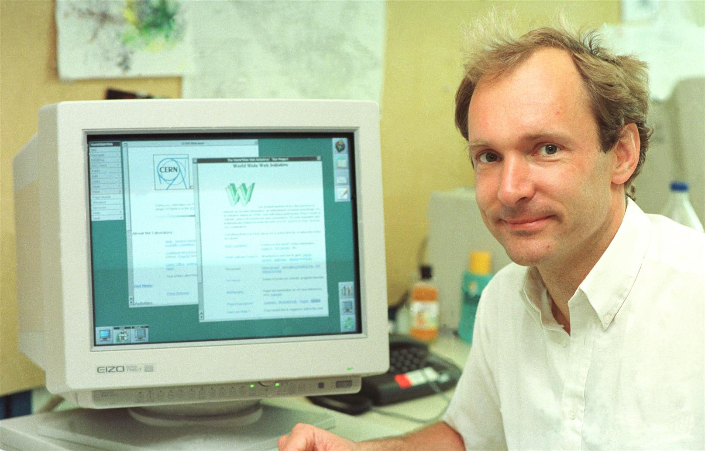
World Wide Web(WWW)
1990
Invented at CERN by Tim Berners-Lee.
Added the commercial applications to the Internet.

Slide 63
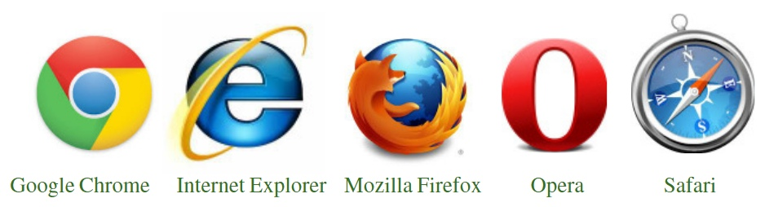
Web Browsers

Slide 64
Web Browsers - Privacy?

Slide 65
INTERNET ADMINISTRATION
Five Regional Internet Registry (RIRs) charged with ensuring the fair distribution and responsible management of IP addresses
AFRINIC
APNIC (The Asia-Pacific Network Information Centre)
ARIN
LACNIC
RIPE NCC

Slide 66
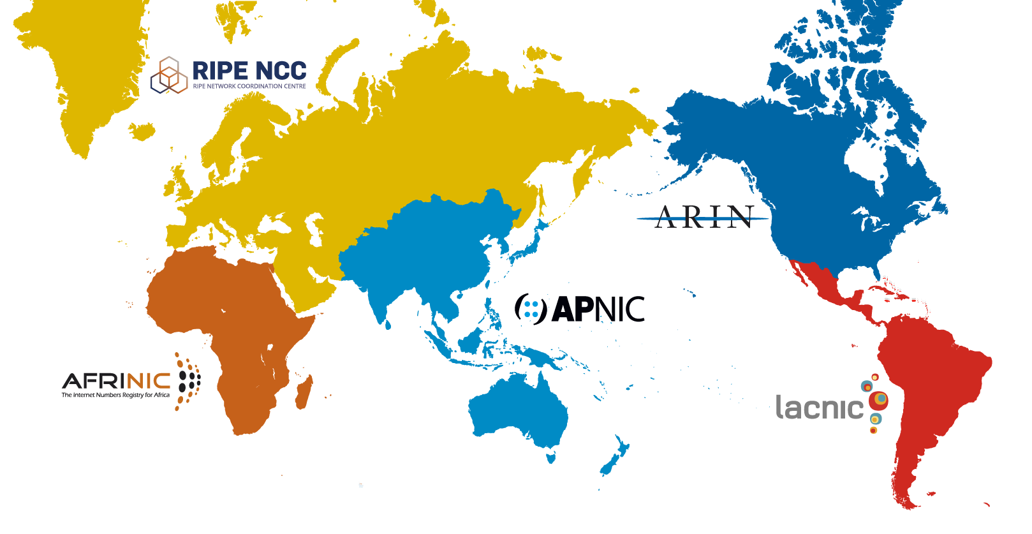
INTERNET ADMINISTRATION

Slide 67
Domain Name System
IP address
157.240.13.35

Slide 68

Domain Name System
IP address
157.240.13.35

Slide 69
Domain Name System
157.240.13.35 is the IP address of facebook.com
DNS provides the mapping between the IP address & domain
https://get-site-ip.com

Slide 70
Why DNS?
Names are easier to remember than numbers
Computers prefer numbers to names

Slide 71
DNS – Top Level Domains
.com
anymore?

Slide 72
DNS – Top Level Domains

Slide 73
Questions

Slide 74
Reach me
@vipinonline
linkedin.com/in/vipingeo
t.me/vipinonline
www.vipinonline.com
E-mail: cek.vipin@gmail.com

Slide 75
Thank You!

